Slide 1
Result Driven Preparation of Poly Correction Tables
Initial Research Report
By Yoav Bar
November 21, 2024

Slide 2
Motivation: Inspired by some AI concepts
The inputs are water phantom scans
+ Working Image Reconstruction SW with special adjustment
There is an easily measured goal: Flatness of all the water volumes
There is an infinite space of possible poly tables
In the tables, for each tube and each detector there are 3 coefficients
The function from the tables’ space to the target space is continuous
Search to minimize “loss” – deviation from flatness
Performing small corrective steps – accept only steps that reduce loss

Slide 3
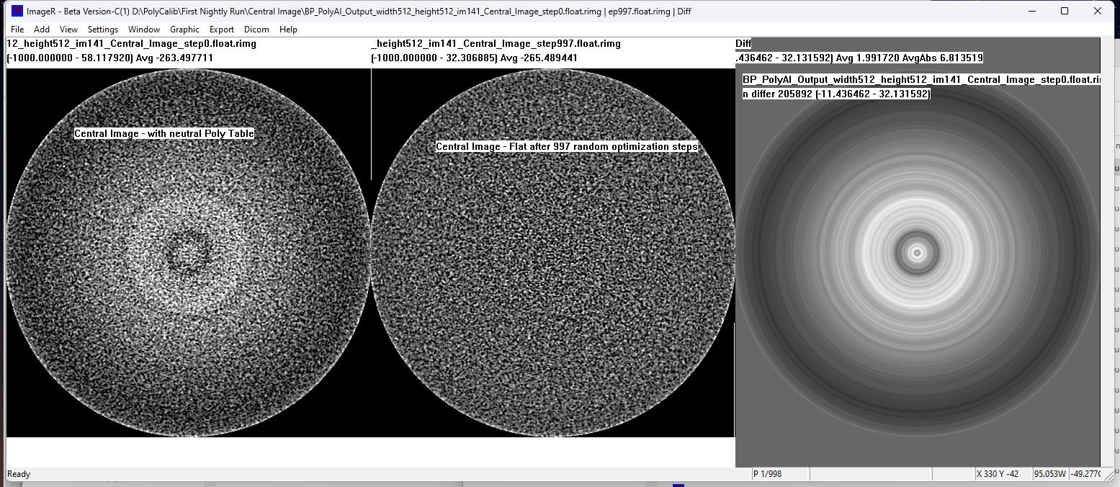
Proof Of Concept with a Single Image

Slide 4
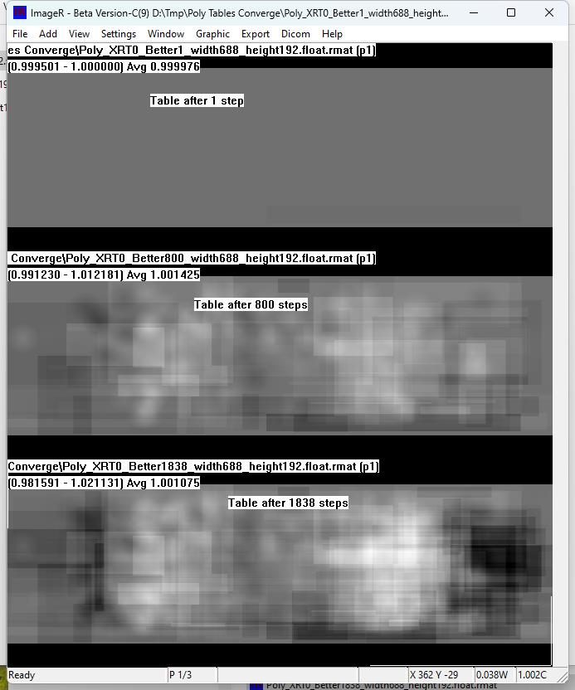
Tables converge gradually with random rectangular patches

Slide 5
Basic Challenges / Constrains
For each change in the tables, basic recon (rebinning->filter->BP) should be activated to measure its effectiveness. Time consuming.
In order to use back-propagation, a corner-stone of Deep Learning, we need to implement basic recon functionality by special Deep Learning toolkit. This is possible but not currently in consideration. So there is no back-propagation, and other methods of optimization are used.
There might be “too much freedom” to create optimized solutions, at least for the simplified cases…

Slide 6
Gradual approach
Started with flattening a single image – easily achieved good results.
Currently – work to flatten a single centered volume
Still work-in-progress – developing concepts and methods / SW
Aborting recon after BP
Using 256*256*280 volume
Start working only on the first coefficient
Current GOAL – efficient and reasonable convergence
Next – Work on multiple scans with varying shifts
Only multiple scans can indicate the value of the second and third coefficients

Slide 7
First Prototype on a single volume
Complicated loss function to assess flatness
Simple correction step –
Ready patches
Random location
Random (small) amplitude
➔ Consistent convergence
➔ Too slow to be effective
➔ Progress becomes slower over time

Slide 8
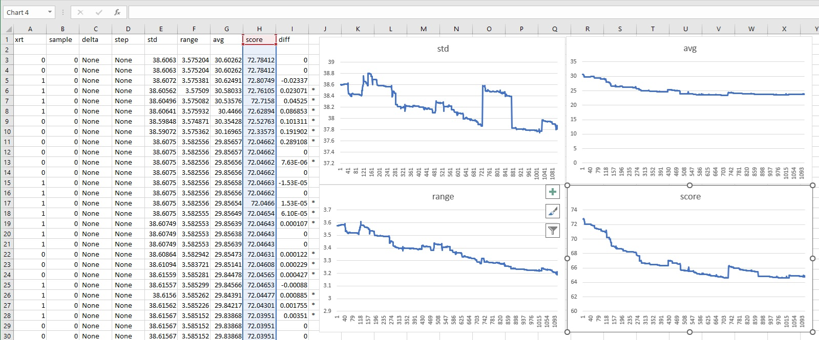
Convergence getting slower over time

Slide 9
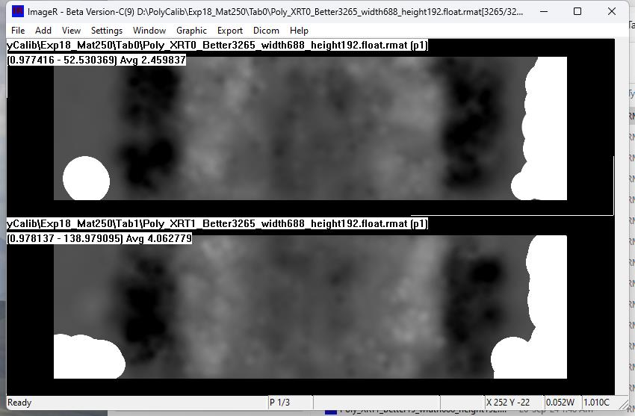
Tables were converging in a patchy way Marginal detectors had to be neutralized

Slide 10
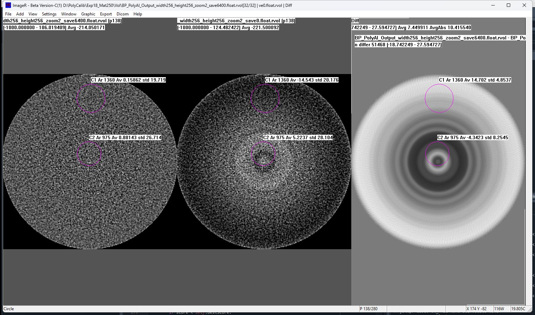
Some images flattened pretty well

Slide 11
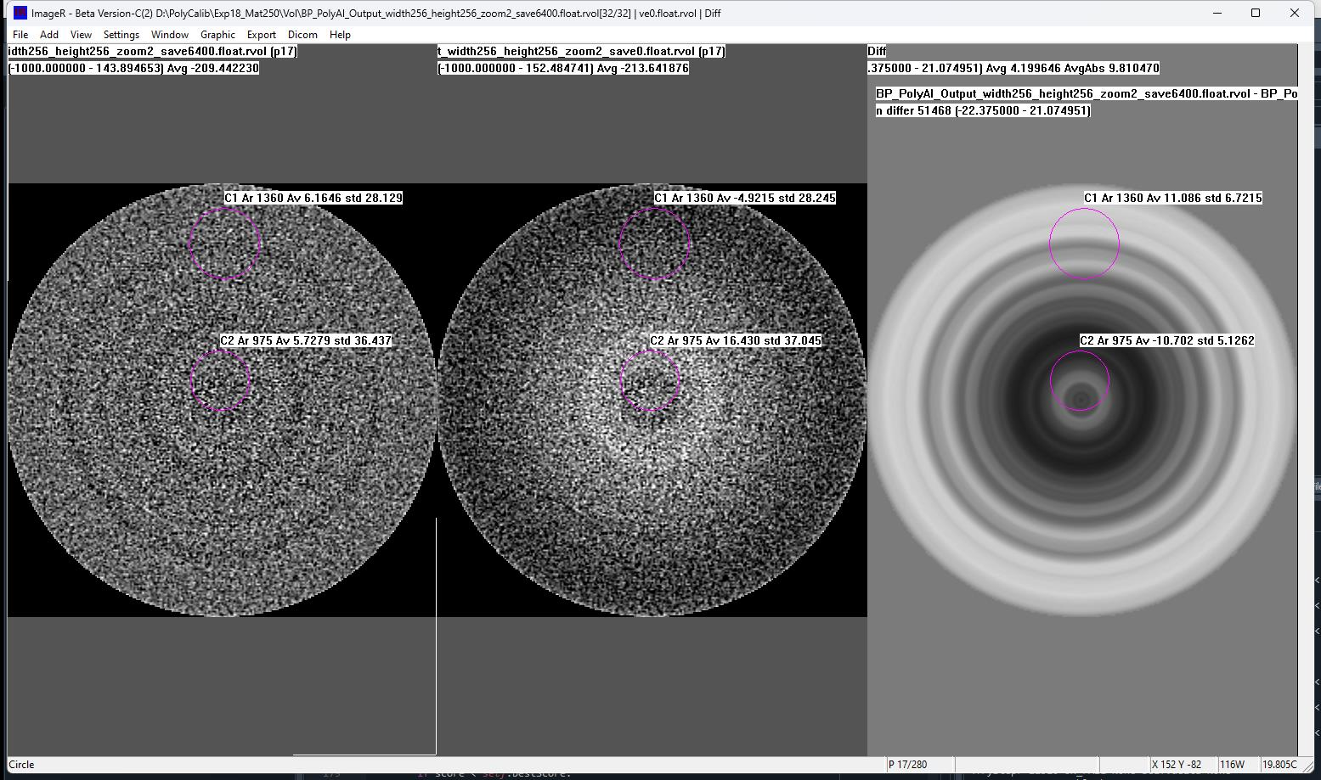
Some images still have bands or rings

Slide 12
New Approach: Targeted Correction
Abandoning random correction – central motivation is accelerated convergence
Direct spatial relation between the tables (the input readings) and the images’ volume
Simple target: flat volume
Characterize problematic features in image space
Adjust specific solutions to specific problems
Faster convergence should allow more tests – for example weighing different improvements and selecting the best

Slide 13
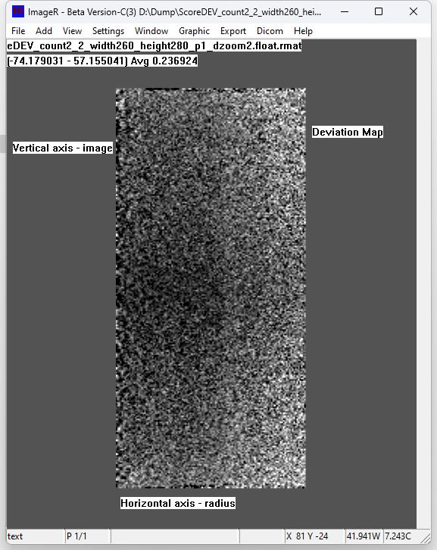
Deviation Map
Simple loss function (“deviation”)
Distance from flat target
Average along image ring
Loss is average abs deviance
Deviation Map
per image and per ring

Slide 14
Targeted Correction
Find worse score (highest deviation) in the deviation map
Characterize the problem in the target area:
Location
Spatial Expansion / Shape
Amplitude
Convert to tables space and try it
Choose tube, choose left or right detectors [up to 4 options]
Try partial corrections
Choose best

